Slide 1

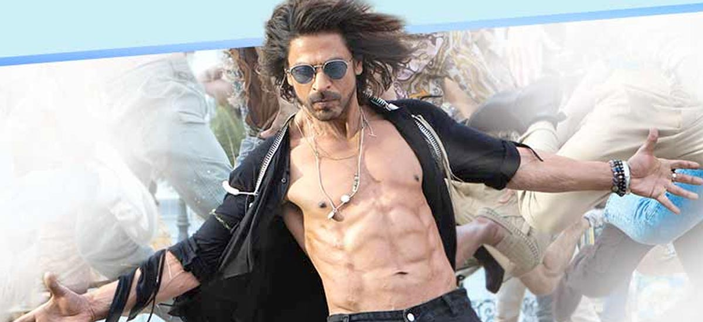
CAPSTONE PROJECT: Comparative Analysis of Machine Learning Models for Bollywood Movie Success Estimation
Dataset: Indian Movies from IMDb (Kaggle)

Slide 2
Problem Statement
The evaluation of these models encompasses a diverse set of metrics, including (MSE), (RMSE), (MAE), and (R2) , to gauge their performance and suitability in estimating movie success.
To aim to provide invaluable insights into choosing the most effective model for this specific estimation task
To provide comprehensive comparative analysis of four distinct machine learning models using the IMDb India dataset.

Slide 3
Objectives
Model Selection: Evaluate and compare four different machine learning models to identify the most appropriate model
Performance Evaluation: Measure the performance of each machine learning model using key metrics such as (MSE), (RMSE), (MAE), and (R2) to assess their accuracy
Insightful Analysis: Conduct a detailed analysis of the results obtained from each model, identifying strengths
Recommendations and Insights: Provide recommendations and insights derived from the model analysis, suggesting the most suitable machine learning model for estimating Bollywood movie success based on the dataset.

Slide 4
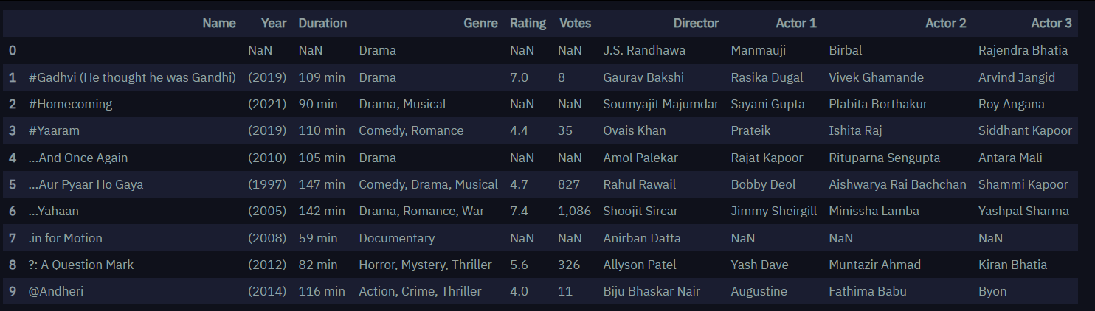
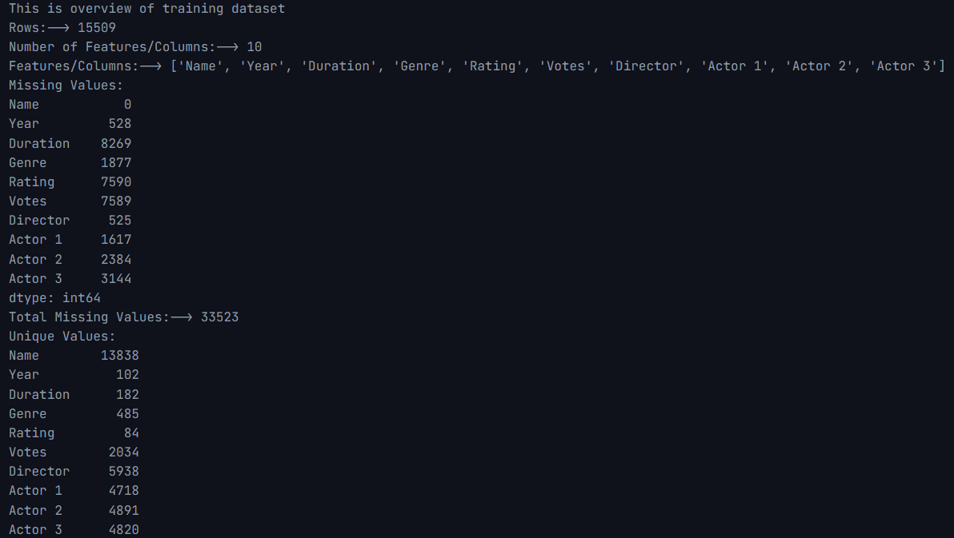
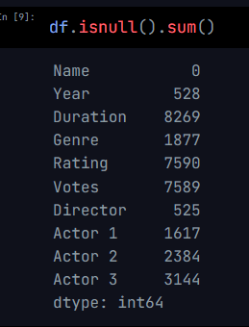
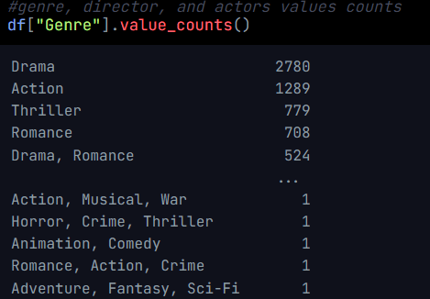
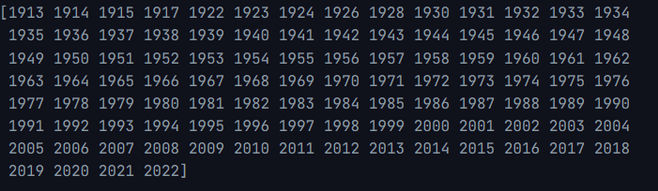
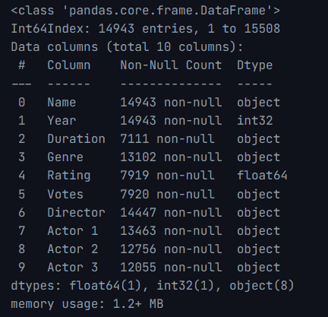
Data Gathering and Preparations
Data overview:
Null values:
Too many Genres(effect EDA)
Future data 2022:
Dtype:
Extra adjustments: Year- “()” Duration – “min”
Votes - changing $5.16M to 516
- removing “, ”

Slide 5
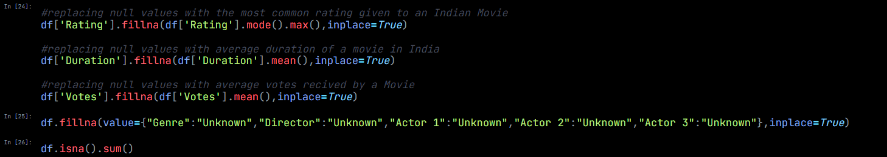
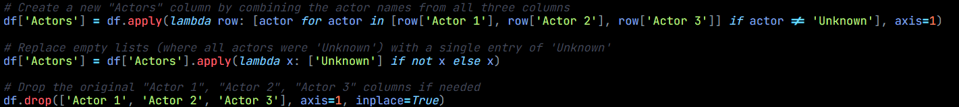
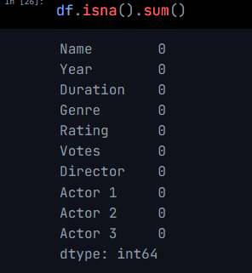
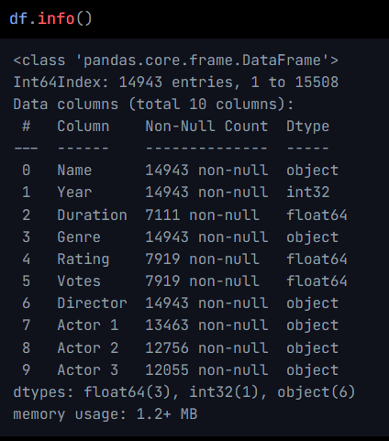
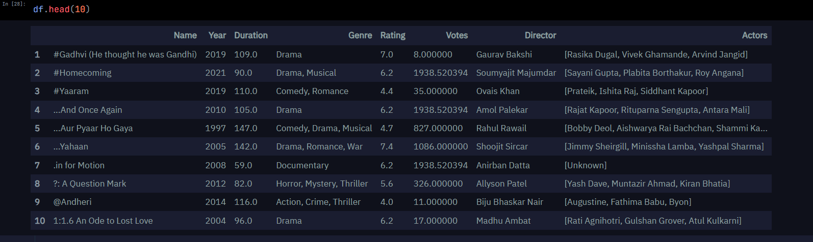
Data Gathering and Preparations
Null values:
Simplify Actors column into single column:

Slide 6
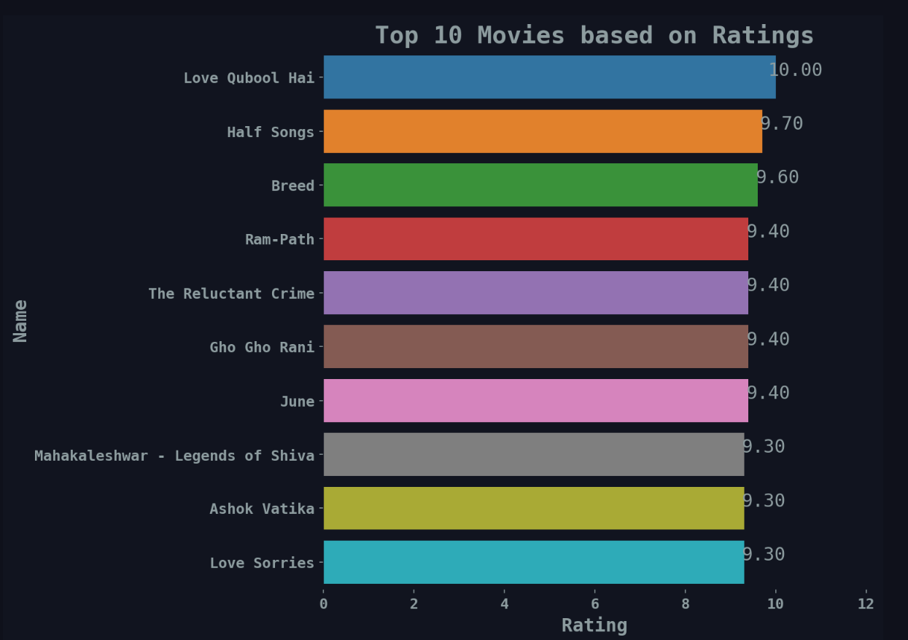
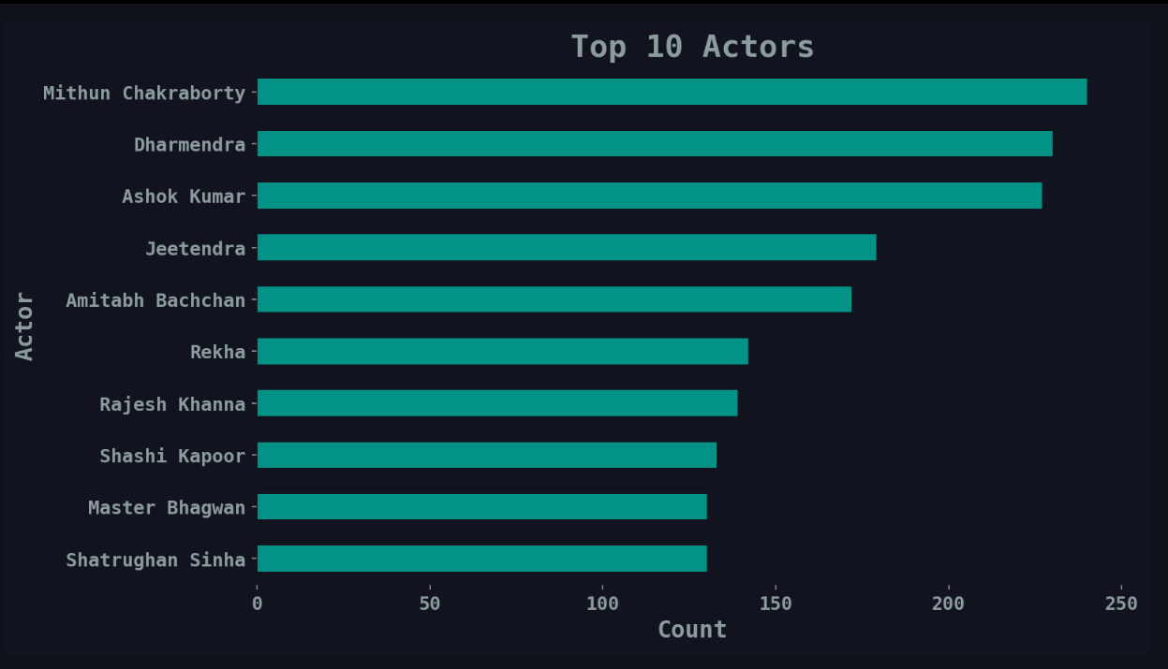
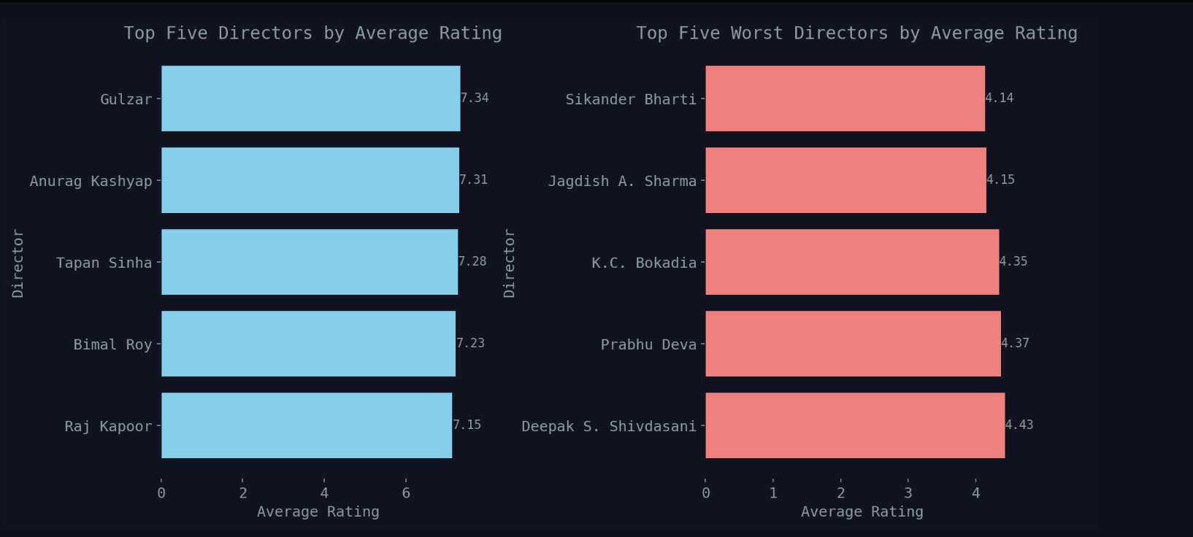
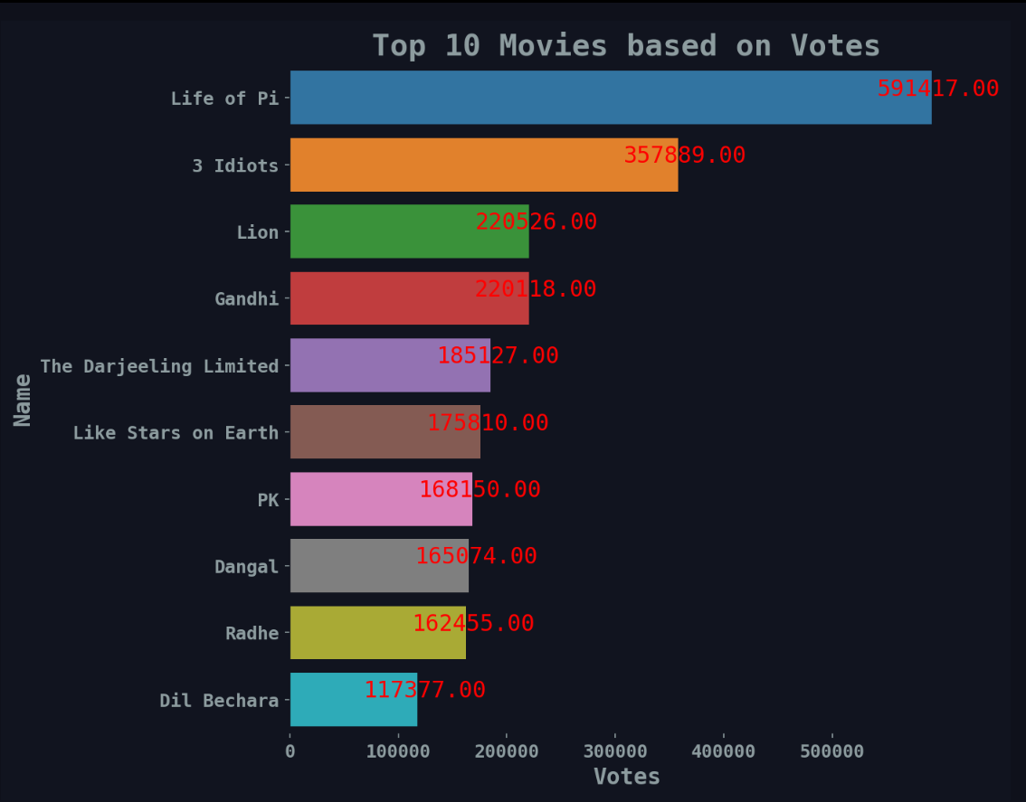
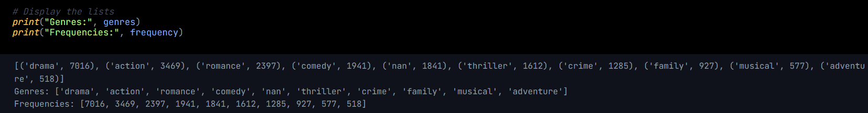
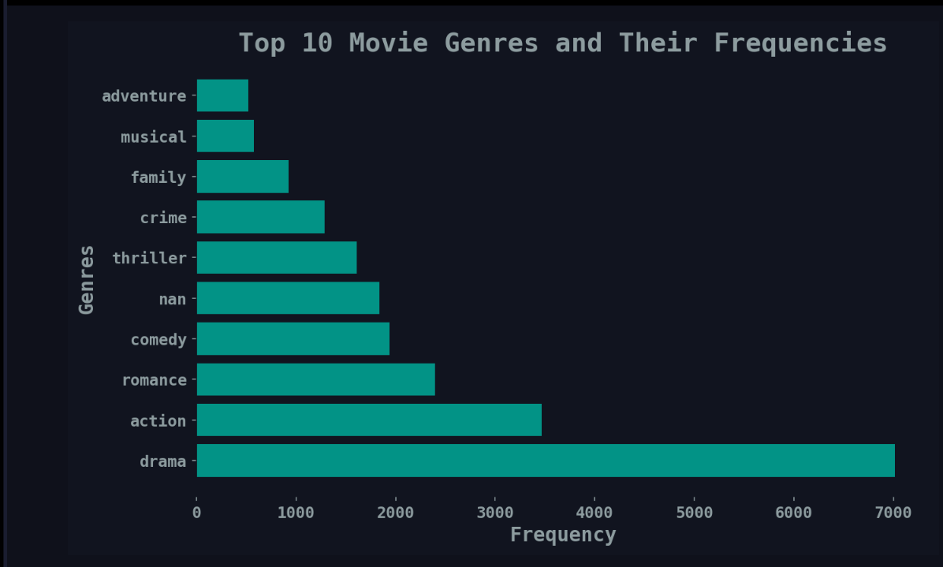
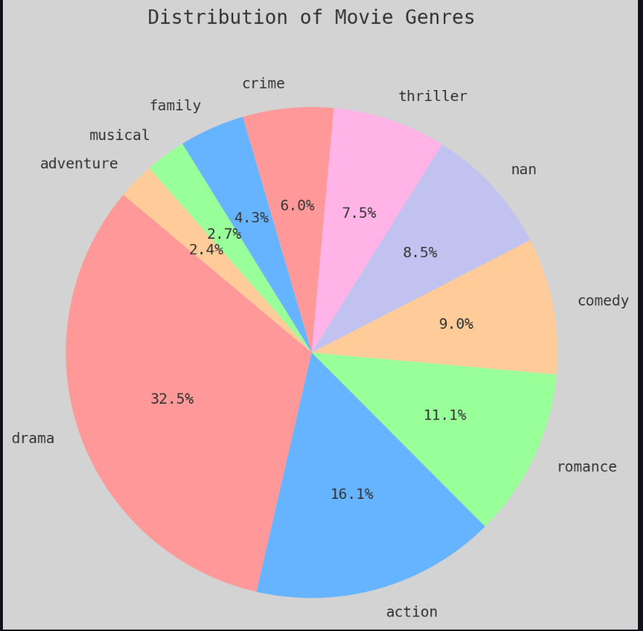
Exploratory data analysis
TOP 10 movies based on rating
TOP 10 Actors who appears in most movies
TOP 5 and top 5 worst Directors -atleast directed 10 movies
TOP 10 movies based on votes
TOP 10 Genre for an Indian movie

Slide 7
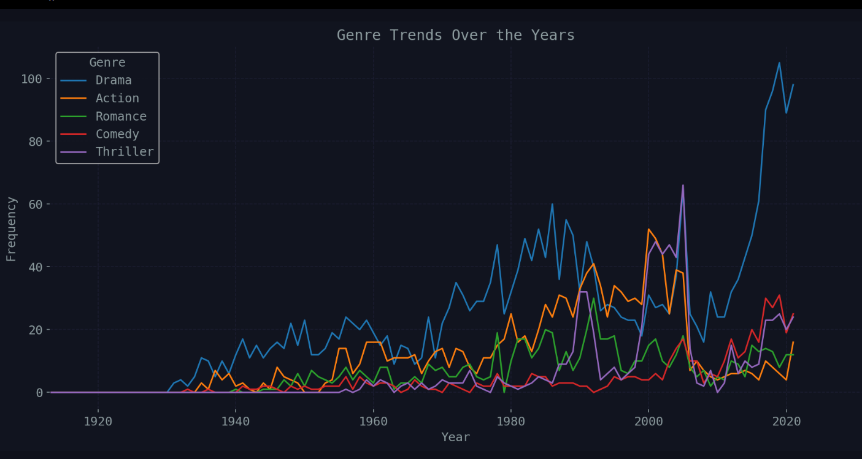
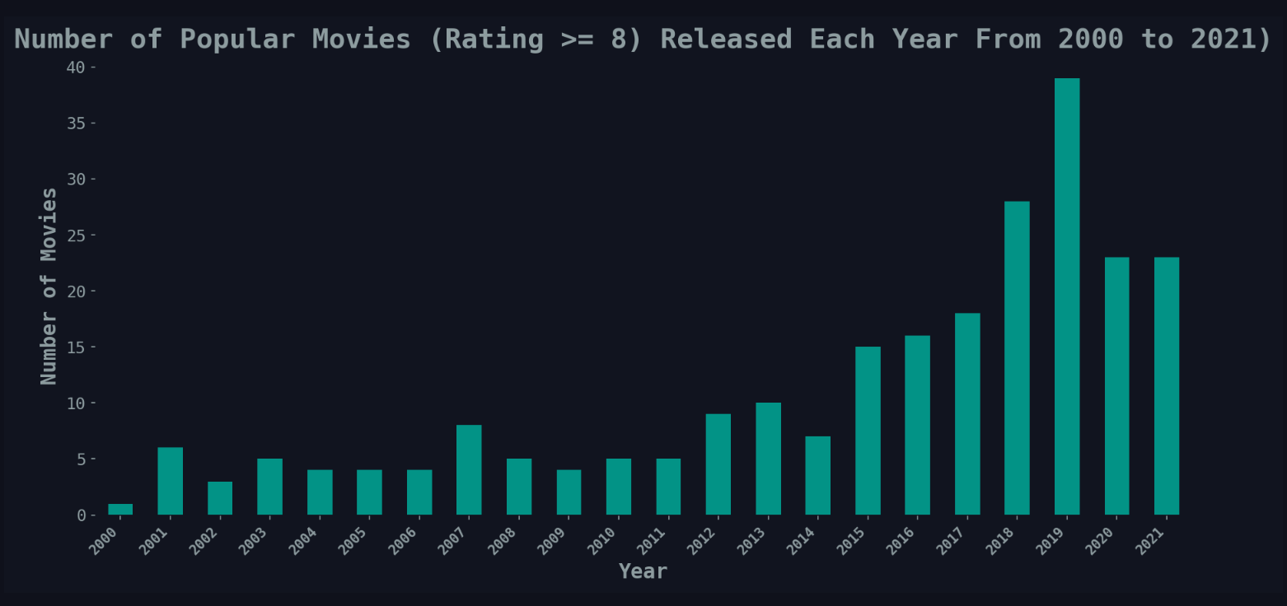
Exploratory data analysis
Genre trends over the years
Number of popular movies released from 2000 to 2021 Rating >=8

Slide 8
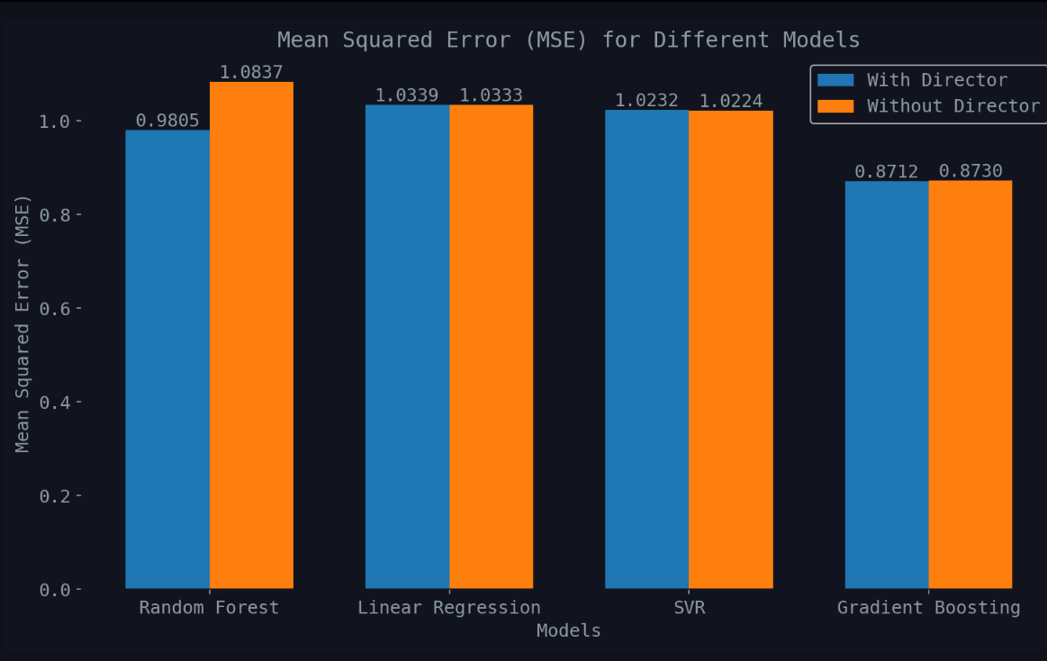
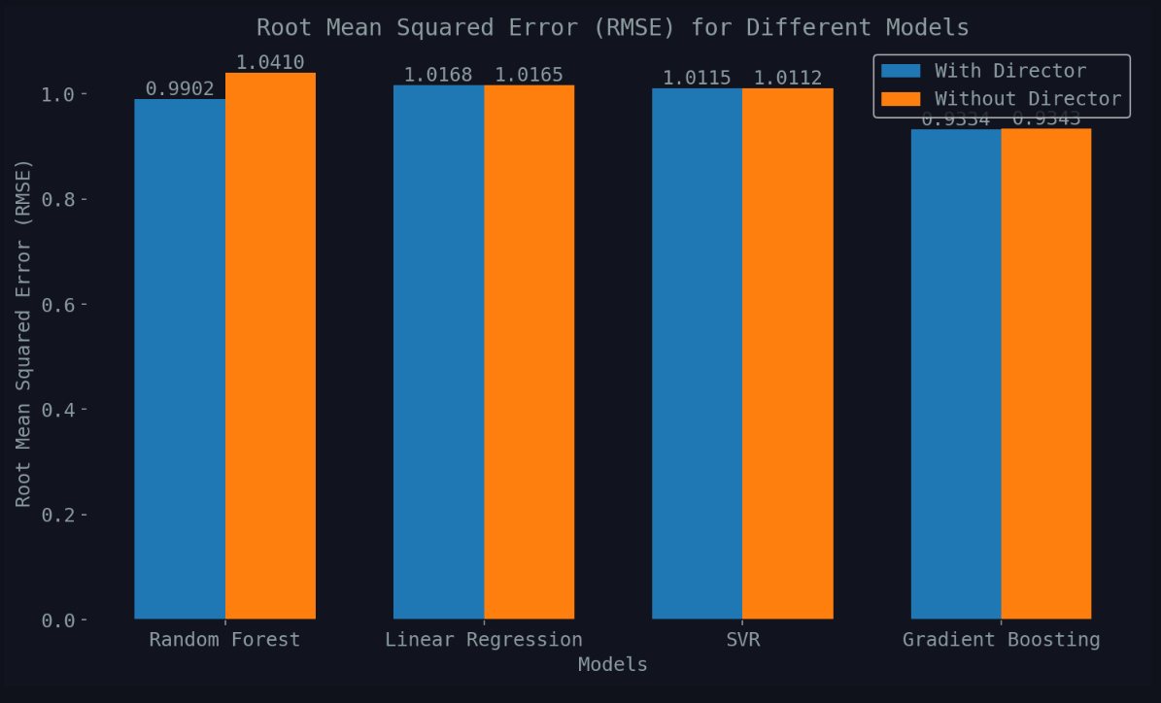
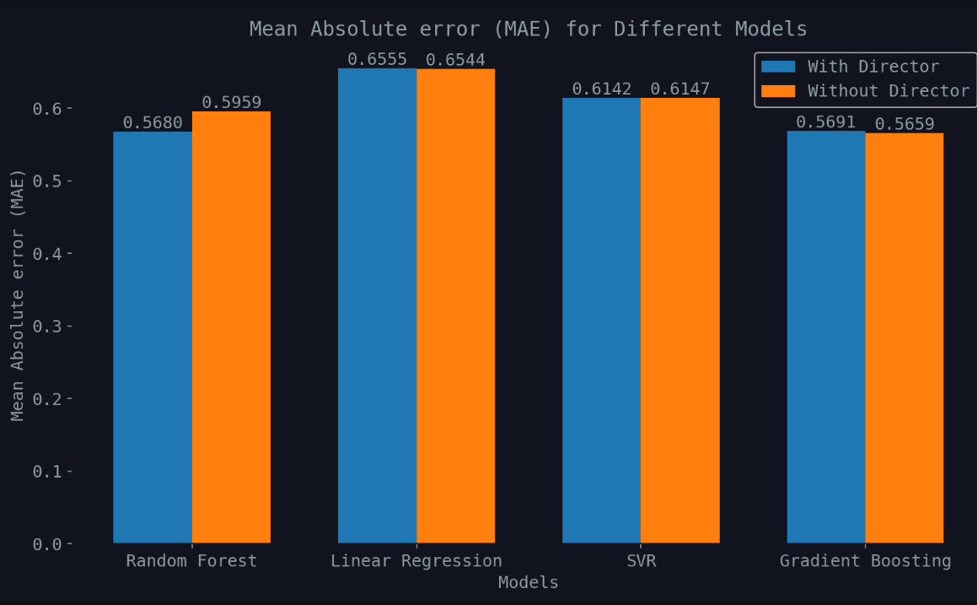
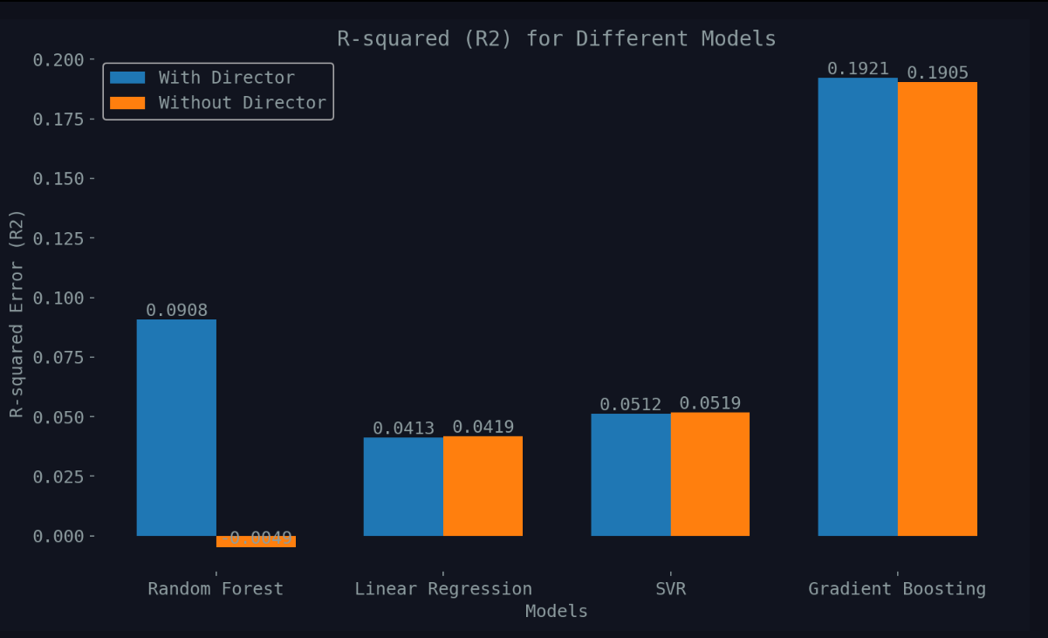
Data Modeling & Evaluation
Testing four model with and without director as Feature to see director influence the modeling accuracy.
# Features including 'Genre', 'Votes', 'Director'
X_with_director = df[['Genre', 'Votes', 'Director’]]
or
# Features including 'Genre', 'Votes’
X_without_director = df[['Genre', 'Votes']
# Target variable
y = df['Rating']
Models:
RandomForestRegressor
LinearRegression
SVR
GradientBoostingRegressor
Evaluation metrics:
MSE
RMSE
MAE
R2

Slide 9
Recommendation & Summary
Recommendation:
Utilize the gradient boosting model for predicting movie ratings
Further feature engineering to enhance prediction accuracy and improving the models
Incorporate feature scaling
Model Versioning and Updates to keep the predictions accurate and up-to-date
Summary:
Gradient Boosting emerged as the top performer, displaying the lowest (MSE), (RMSE), and (R²) compared to the other models.
A lower MSE and RMSE indicate that the model's estimations are close to actual success metrics, while a higher R² value signifies a better fit of the model to the data.

